Slide 1

Capacitive Touch Screen Technology
capacitive touch screen
Notes:
<number>
16 February 2014

Slide 2
Outline:
Introduction
History
Components of Touch Screen
Capacitive touch screen technology
Types of Capacitive touch screen
Advantages & Disadvantage
Applications
Future Scope
Conclusion
Notes:
<number>
16 February 2014

Slide 3
Introduction
A touch screen is a computer display screen that is sensitive to human touch, allowing a user to interact with the computer by touching pictures or words on the screen.
A touch screen is an input device that allows users to operate a PC by simply touching the display screen which has a sensitive glass overlay placed on it.
A touch screen accepts direct onscreen inputs.
Notes:
<number>
16 February 2014

Slide 4
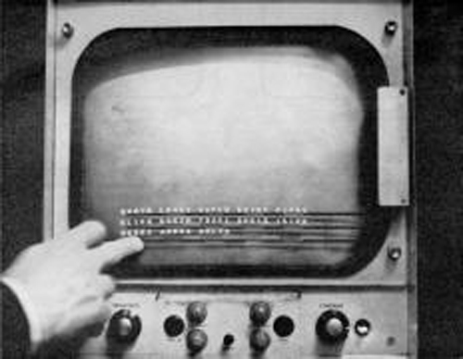
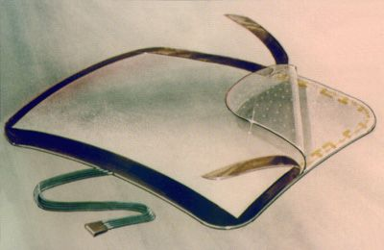
History
In 1965, the first "touch screen" was developed by E.A. Johnson .
In 1971, the first “transparent touch screen" was developed by Dr . Sam Hurst.
The University of Kentucky Research Foundation named it as “Elo-graph”.
Notes:
<number>
16 February 2014

Slide 5
Components of Touchscreen (How Does A Touchscreen Works?)
A basic touch screen has three main components:
Touch Sensor
Controller
Software Driver
Notes:
<number>
16 February 2014

Slide 6
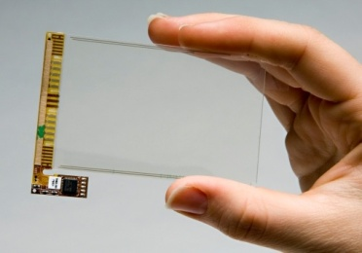
Touch Sensor
The sensor generally has an electrical current or signal going through it and touching the screen causes a voltage or signal change.
A touch screen sensor is a clear glass panel with a touch responsive surface which is placed over a display screen.
Notes:
<number>
16 February 2014

Slide 7
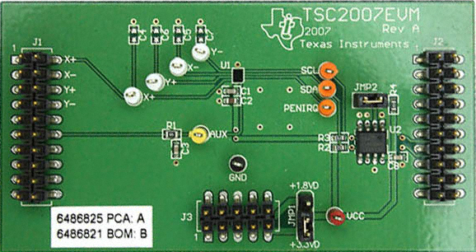
Controller
The controller is a small PC card that connects between the touch sensor and the computer.
It takes information from the touch sensor and translates it into information that computer can understand.
Notes:
<number>
16 February 2014

Slide 8
Software Driver
The driver is a software that allows the touch screen and computer to work together.
It tells the operating system how to interpret the touch event information that is sent from the controller.
Most touch screen drivers today are mouse-emulation type drivers. This makes touching the screen the same as clicking your mouse at the same location on the screen.
Notes:
<number>
16 February 2014

Slide 9
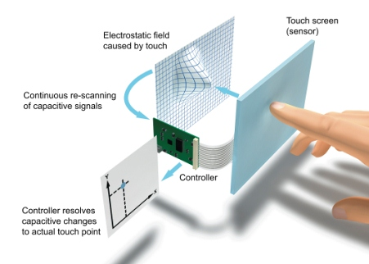
Diagram showing How it Works
Notes:
<number>
16 February 2014

Slide 10
Capacitive Touchscreens
Two types:
Surface Capacitive Touchscreens.
Projected Capacitive Touchscreens.
Notes:
<number>
16 February 2014

Slide 11
Surface Capacitive Touch Screen Technology
In the capacitive system, a layer that stores electrical charge is placed on the glass panel.
When a user touches, some of the charge is transferred to the user, so the charge on the capacitive layer decreases.
This decrease is measured in electrodes located at each corner of the monitor.
The computer then calculates the coordinates, from the relative differences in charge at each corner.
Notes:
<number>
16 February 2014

Slide 12
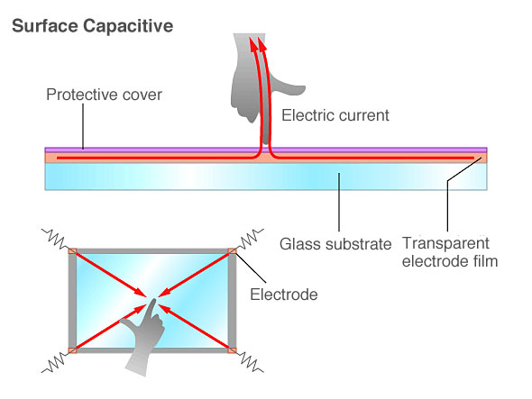
Contd.
Surface capacitive technology consists of a uniform conductive coating on a glass panel.

Slide 13
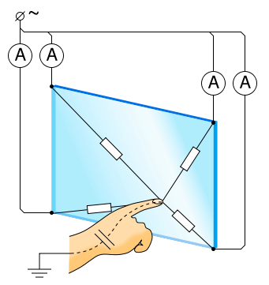
Contd.
A finger touch draws current from each corner.
Then the controller measures the ratio of the current flow from the corners and calculates the touch location.
Notes:
<number>
16 February 2014

Slide 14
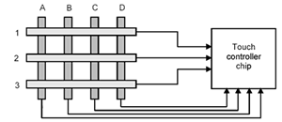
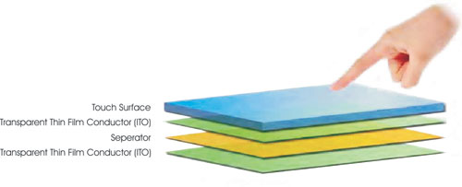
Projected Capacitive Touchscreen
Projected capacitive touchscreens have front and back protective glass providing optical and strength enhancement options.
Its middle layer consists of a laminated sensor grid of micro-fine wires, and optical enhancement options.

Slide 15
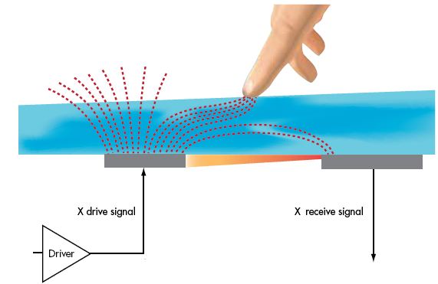
Contd.
During a touch, capacitance forms between the finger and the sensor grid. The embedded serial controller in the touchscreen calculates touch location coordinates and transmits them to the computer for processing.

Slide 16
Advantage
High touch resolution.
High image clarity.
Not affected by contaminant.
User friendly.
Fast response.
Error free input.
No keyboard necessary.
Notes:
<number>
16 February 2014

Slide 17
Disadvantage
Finger stress
Fingerprints
Accepts input from finger only.
big screen leads to low battery life.
Notes:
<number>
16 February 2014

Slide 18
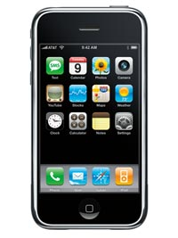
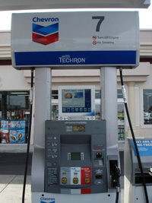
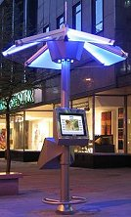
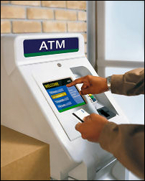
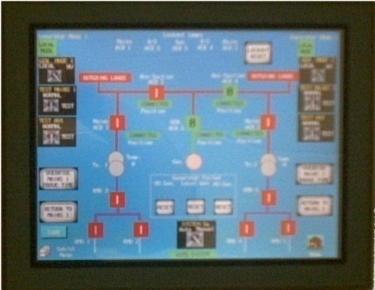
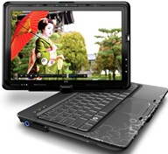
Applications
ATMs.
Phones.
Computers.
Gaming machines.
Point of Sale
Industrial controls.
Hand held electronics.
Notes:
<number>
16 February 2014

Slide 19
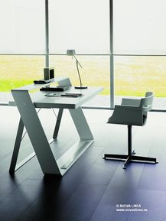

Future Scope
Woodtouch
Touchscreen Video Projectors.

Slide 20
Conclusion
Though the capacitive touch screen technology contains some limitations. it’s very user friendly, fast, accurate, easy for the novices & fun to operate.
Touchscreens, touch panels or touchscreen panels are display overlays which have the ability to display and receive information on the same screen.
Notes:
<number>
16 February 2014

Slide 21
Thank You
Notes:
<number>
16 February 2014

